Slide 1






DataVerse
Africa
Custom Trade Analytics
Internship Presentation
Presented By:
GROUP 15
Babatunde Matthew Oladoyinbo
Elma Fortunate Phiri

Slide 2


Problem Statement
The dataset contains various features and tax collected across different custom offices in Nigeria for 3 years plus.
The analysis done was to track Tax generation and factors that affects it and give best optimized recommendation to increase and optimize Tax generation for the Federal government of Nigeria.

Slide 3

Project Objectives
The primary objective of this analysis is to optimize tax generation for FG of Nigeria.
Also, other aspects are to be investigated for recommendation and optimization as well such as Logistics and Infrastructural aspects.

Slide 4
Introduction
Nigeria as an import-dependent economy state relies a lot on tax generation to fund her budget and financial activities of which Tax generation/collection is a large portion which is the second means of funds for her after Petroleum Trade.
Tax generated at various Custom offices in Nigeria forms a substantial of the total tax generated in Nigeria, making importation a very important trade for the Federal Government(FG) of Nigeria.
Hence, we analyzed the provided dataset in order to optimize tax generation and track the best means of reducing cost/losses.

Slide 5
Methodology
In order to achieve the objective of this analysis, the following methodology was adopted;
Data Collection
Data Preprocessing
Exploratory Data Analysis
Predictive analysis

Slide 6
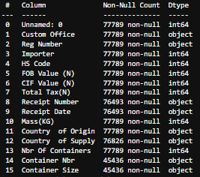
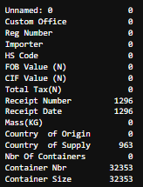
Methodology
Data Collection
Records of Importation and Taxes paid (77,000+ records) and other features were collected in a csv file and the features present and types are as shown in the LEFT table and the missing values are presented like wise in the RIGHT side.
The Preprocessing was done as instructed by the Stake holder.

Slide 7
Methodology
Data Preprocessing >>> Data Cleansing
Missing values were filled as instructed by the stakeholder and data type validation was done as well.
The missing values were treated as shown below;
Receipt number -- Unknown receipt number
Receipt Date -- Fill with Mode
Country of Supply -- No country
Container Nbr -- Unknown container number
Container Size -- Unknown container size

Slide 8
Methodology
Data Preprocessing >>> Feature Engineering
Based on our research new features were generated from the given features.
The following new features were generated and added to the dataset in order to provide more information in our analysis
Freight and Insurance cost per transaction = CIF - FOB -- Cost impact of shipping and insurance -- CIF – FOB
Freight and Insurance Cost ratio = (CIF - FOB)/FOB -- Measures how much shipping contributes to total cost -- (CIF - FOB)/FOB
FOB value per KG = FOB/Total weight -- Helps compare goods base value independent of value -- <FOB/KG>
CIF value per KG = CIF/Total weight -- CIF cost per KG -- <CIF/KG>
Effective Tax Rate per Transaction = Total Tax/CIF -- Evaluates tax burden on imported goods -- <Tax/CIF>
Total Tax as % of FOB = Total Tax/FOB -- Measures taxation relative to product bases cost -- <Tax/FOB>
Tax per KG = Total Tax/ Total Weight -- Helps compare taxation levels across different products -- <Tax/KG>

Slide 9
Data Insights
Presenting key findings and insights from the data analysis

Slide 10
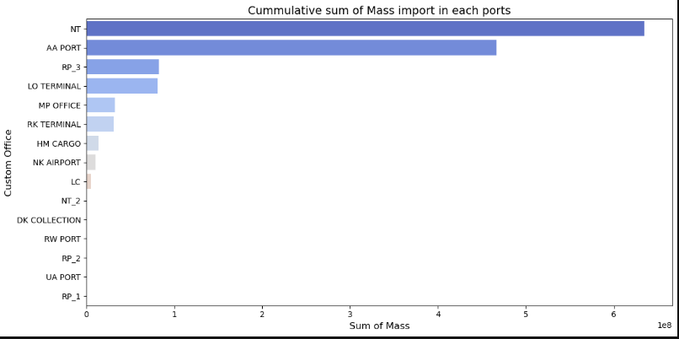
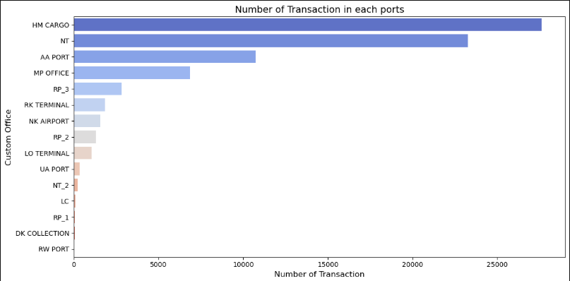
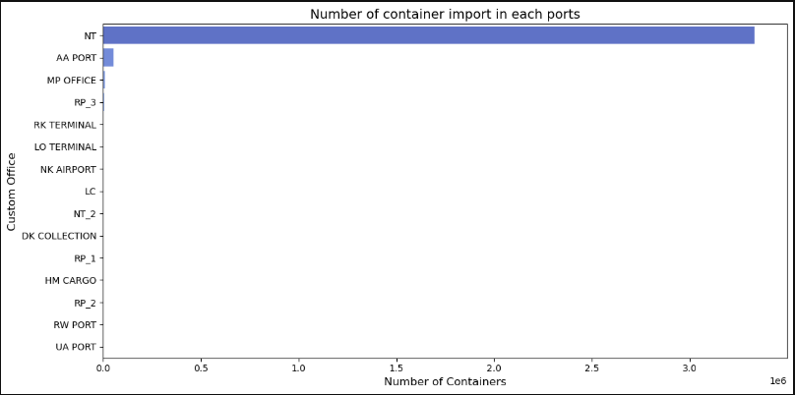
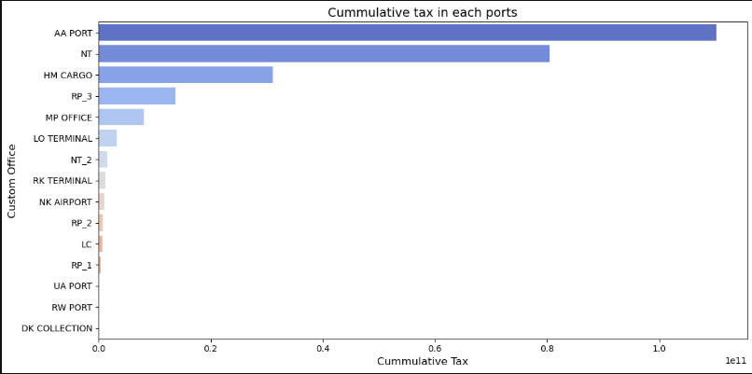
Exploratory Data Analysis
Custom Office/Ports Ranking

Slide 11
Exploratory Data Analysis
Custom Office/Ports Ranking
INSIGHTS
Since to the advantage of the Federal government of Nigeria, the Tax charged is a source of revenue generation, the Federal government will be more interested in the most lucrative ports, which happens to be AA PORT with 110,177,600,000 Naira made in 1385 recorded days (44% of total tax generated). Followed by NT port with 80,390,360,000 Naira (32% of total tax generated) as well.
So we shall look into these top 5 ports to see what happened and give recommendations based on that.
AA PORT, NT Port, HM CARGO, RP_3, MP_OFFICE.
.

Slide 12
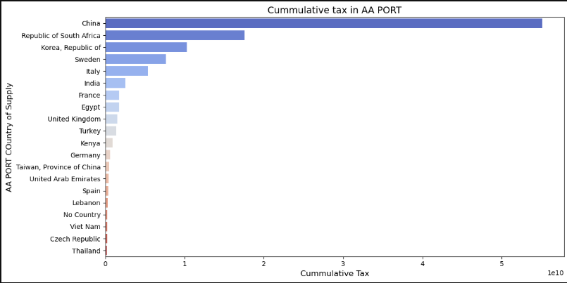
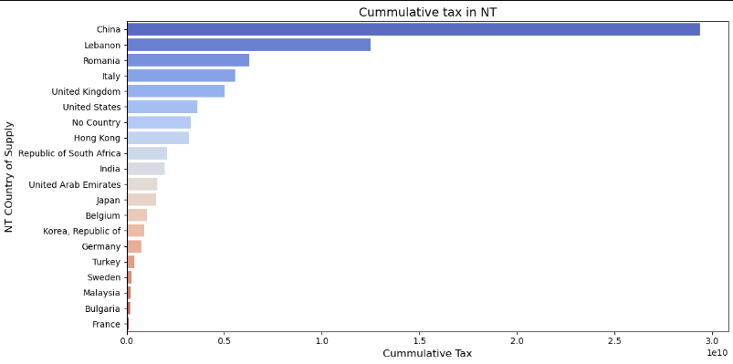
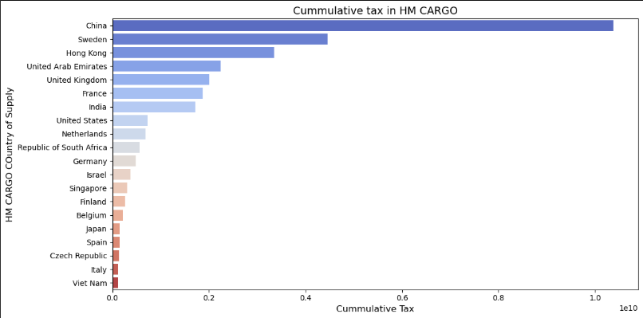
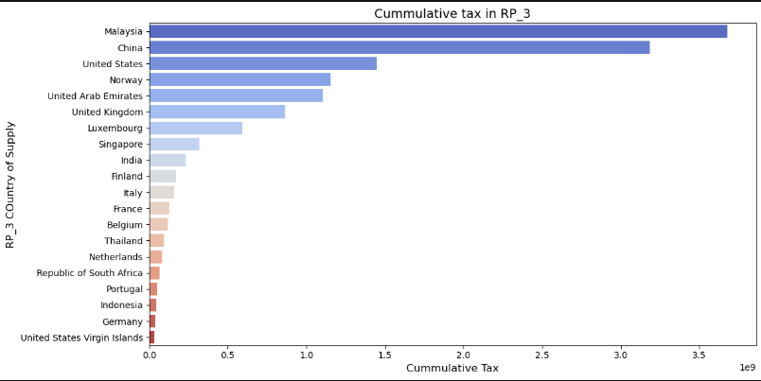
Exploratory Data Analysis
Based on the Top 5 tax generating ports, which country imports most?

Slide 13
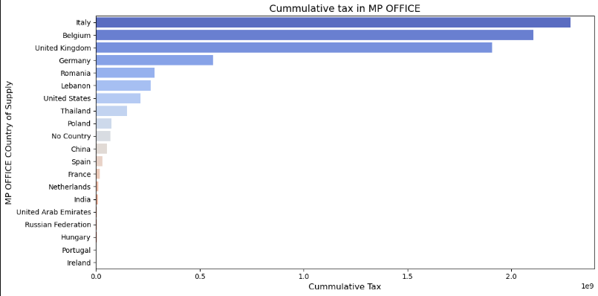
Exploratory Data Analysis
Based on the Top 5 tax generating ports, which country imports most?
INSIGHTS:
Looking into the top 5 ports with the highest Tax generation, it was observed from above that based on the country of supply of imports, China is the country that supplies the top ports most AA PORT, NT and HM CARGO, generating a sum of 9,484,4160,000.0 Naira in these 3 ports but a total of 102,009,600,000 Naira which is about 40% 0f the total taxes generated followed by Republic of South Africa with 8%.

Slide 14
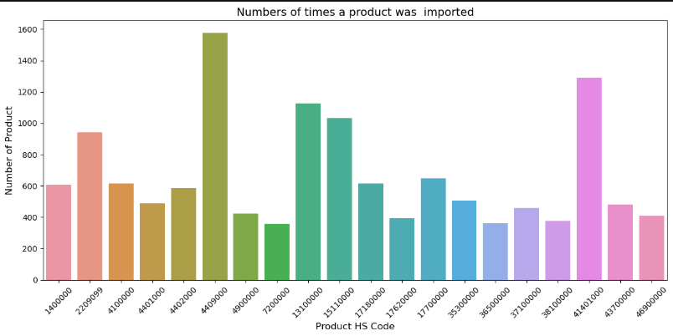
Exploratory Data Analysis
Since China is holding 40% of the tax generated, what products are imported from China?

Slide 15
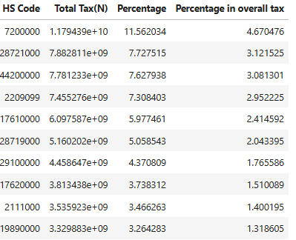
Exploratory Data Analysis
Since China is holding 40% of the tax generated, what products are imported from China?
OBSERVATIONS:
Products with the HS Code of 7200000 brings 12% of the taxes paid from China which is 11,794,390,000. It is observed that this product was imported about 370+ times with total weight of 31795077 KG. Same product accounts for 4.6% of the taxes generated.
We try to trace the Importers that imports these top 10 products which accounts for over 60% of China tax.
A-list products - 7200000,28721000,44200000,2209099,17610000,28719000,29100000,17620000,2111000,19890000.

Slide 16
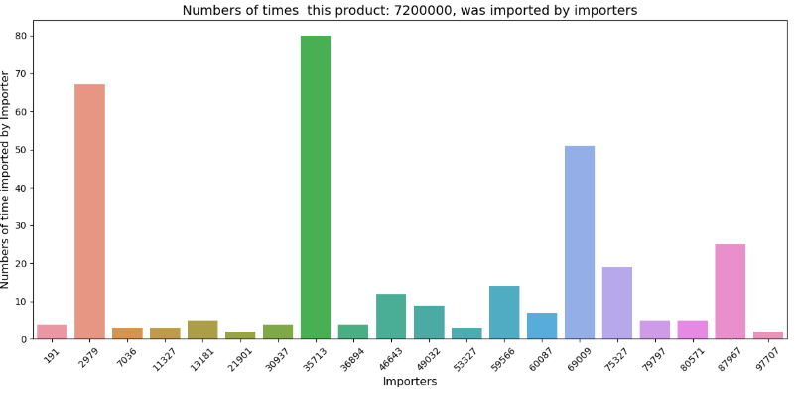
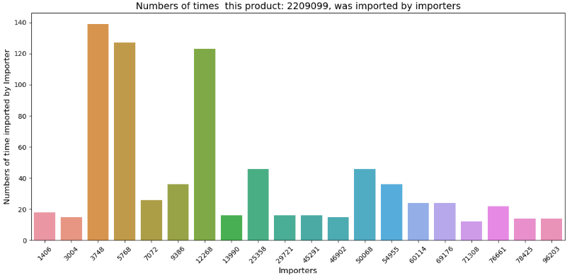
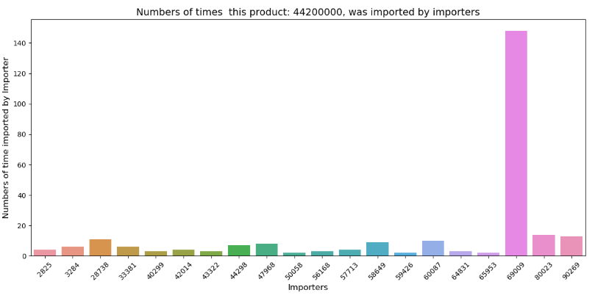
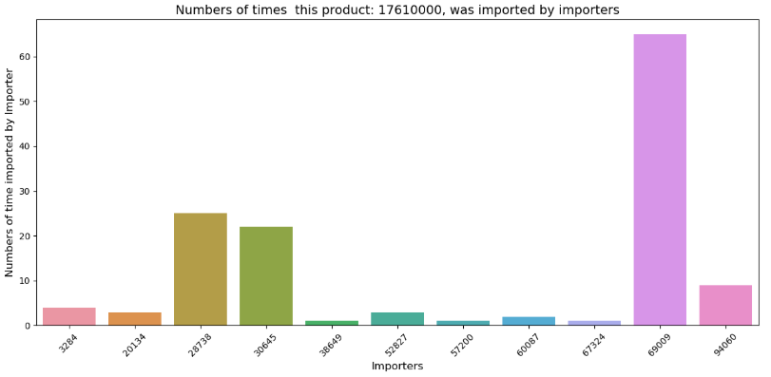
Exploratory Data Analysis
Based on the A-list Products, which Importers imports them most? Other plots not shown

Slide 17
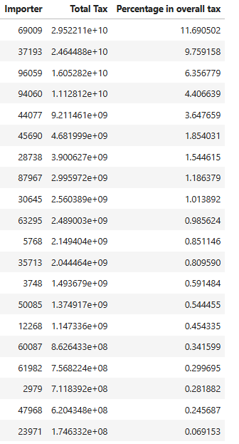
Exploratory Data Analysis
Based on the A-list Products, which Importers imports them most?
OBERVATIONS:
These top 20, A-list Importers contribute to 50% of the taxes on the A- list products from China.

Slide 18
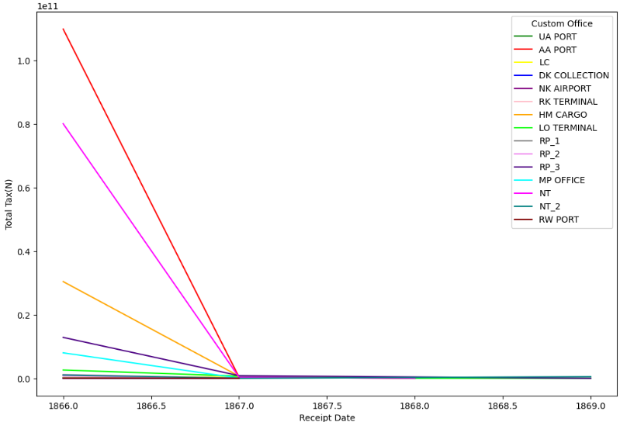
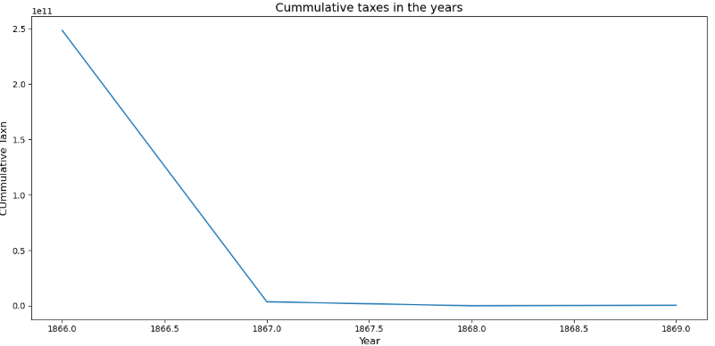
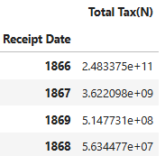
Exploratory Data Analysis
Time line of Tax generation in the Ports
OBSERVATION:
1. It was seen that there was a Great Decline in 1866, after which the tax generated became steady and an increase in 1869.

Slide 19
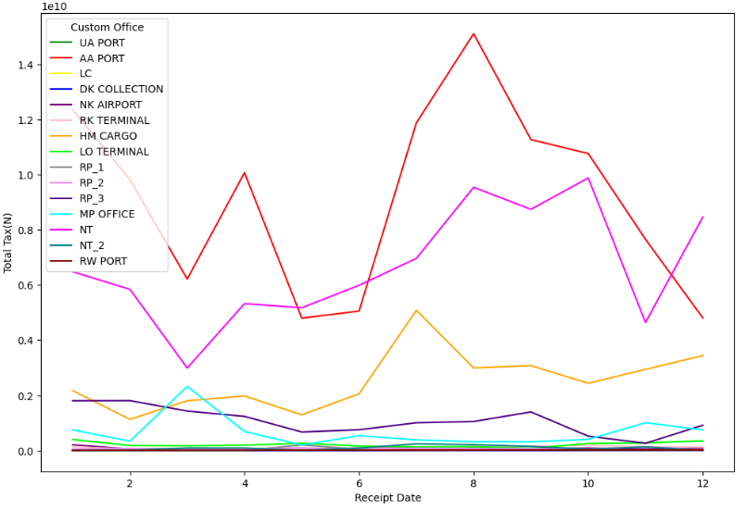
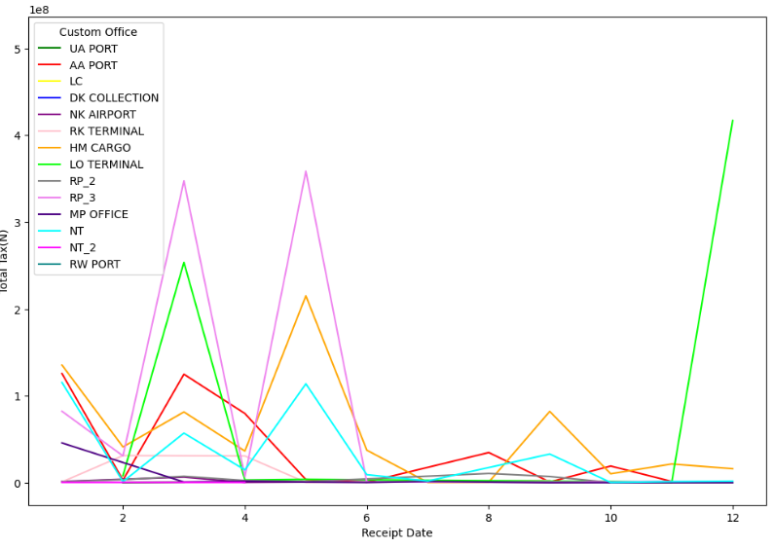
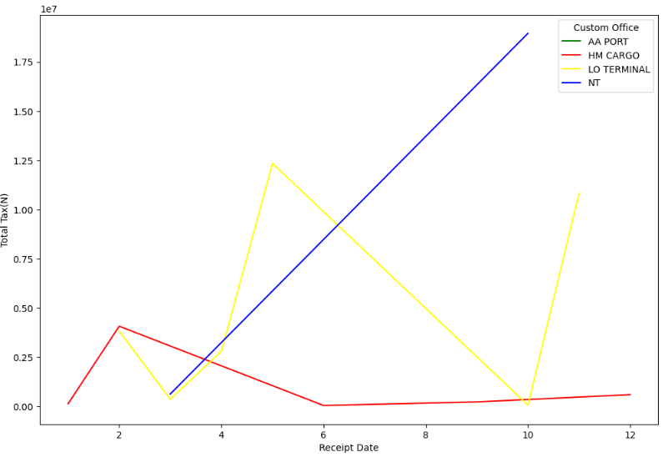
Exploratory Data Analysis
Time line of Tax generation in the Ports
Year 1866 Year 1867 Year 1868
OBSERVATION
1. Across the main 3 years (excluding 1869 because the data is incomplete), there seems to be no regular or repeated patterns other than that every time there is an increase, there is a corresponding decrease.

Slide 20
Exploratory Data Analysis
Time line of Tax generation in the Ports
OBSERVATION
1. Again, we observe just 4 Custom office in 1868. Which as earlier said may be due to absence of data or decommission of office which seems so unlikely as the numbers missing offices record is high.
So, the most reasonable possible reason is Data Gap which could be to various reasons as
Inadequate record keeping resources such as record keeping personnel, storage capacities
Record restriction. The record could be restricted from public access
Another possible reason could be corrupt intention of deliberate withdrawal or destroying records. Embezzlements or Misappropriation
We can't investigate further due to limited data.

Slide 21
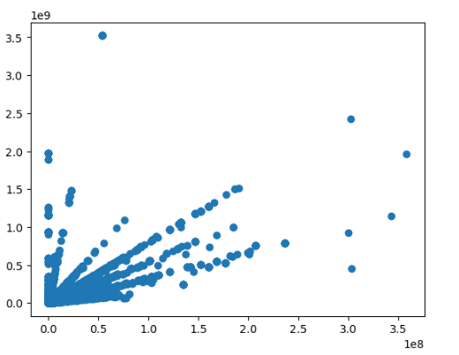
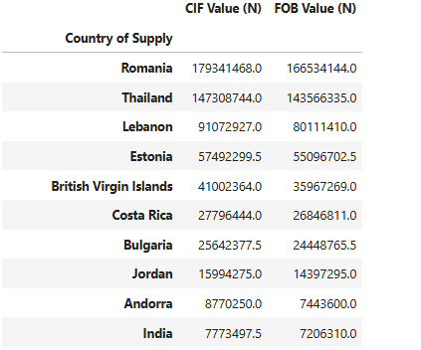
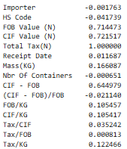
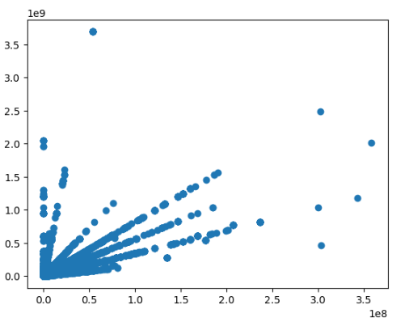
Exploratory Data Analysis
Correlation with CIF value
Tax generation in the Ports Correlation
Correlation with FOB value
RECOMMENDATIONS
Government policies that encourages or aids products from country with high FOB and CIF prices should be encouraged.
Inter government relationship with these countries should be encouraged.

Slide 22
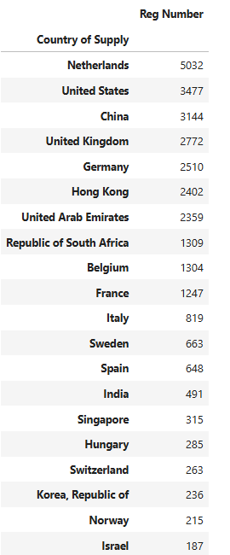
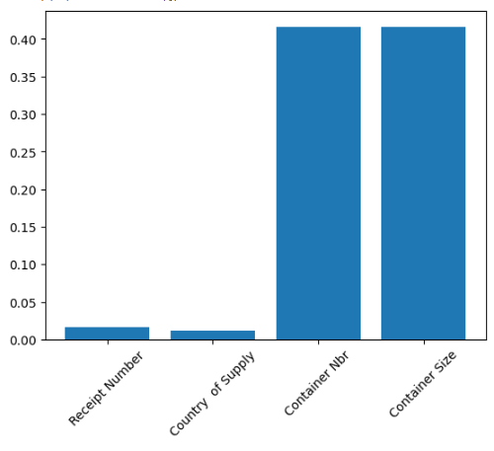
Exploratory Data Analysis
Data Gap Investigation
OBSERVATIONS
Of all features with missing data, details about the Container imported seems to have the highest percentage. The table shows top 20 countries with the highest missing data about Container imports.
RECOMMENDATIONS
1. Imports concerning containers from these countries should be monitored closely and documentations about the Container imports should be supervised closely as well.

Slide 23
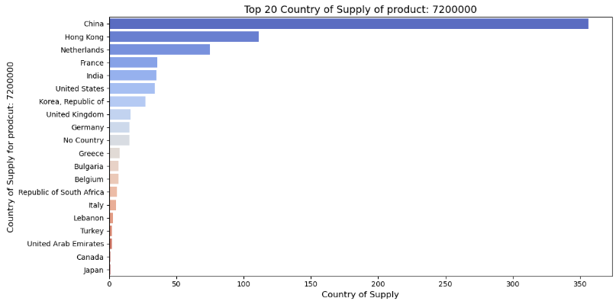
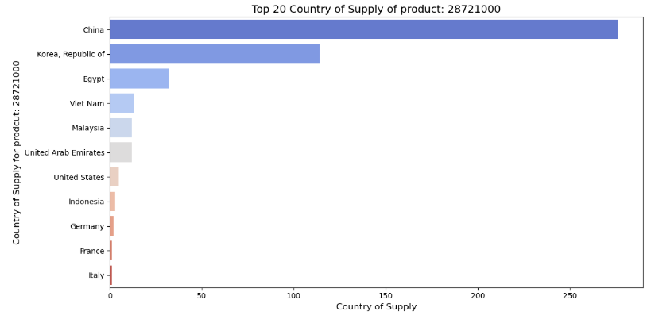
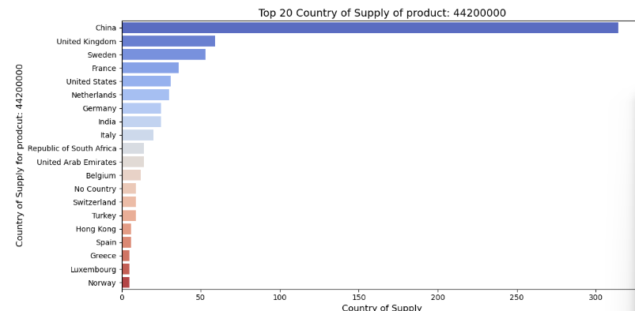
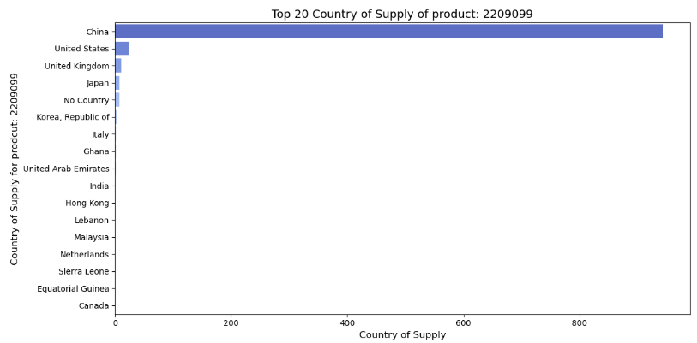
Exploratory Data Analysis
A-list countries for our A-list products NOT ALL VISUALIZATIONS ARE SHOWN

Slide 24
Exploratory Data Analysis
A-list countries for our A-list products NOT ALL VISUALIZATIONS ARE SHOWN
OBSERVATION:
1. For reach of our A-list products, here's a corresponding A-list country of supply.
7200000 – China
28721000 – China
44200000 – China
2209099 – China
17610000 – China
28719000 – Belgium
29100000 – China
17620000 – Netherlands
2111000 -- United Kingdom
19890000 – China
A-list countries = China, Belgium, Netherlands, United Kingdom, Sweden, Hong Kong, United States, German, Korea, Republic of, Egypt.

Slide 25
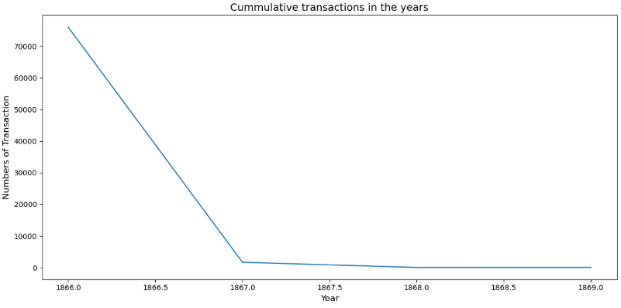
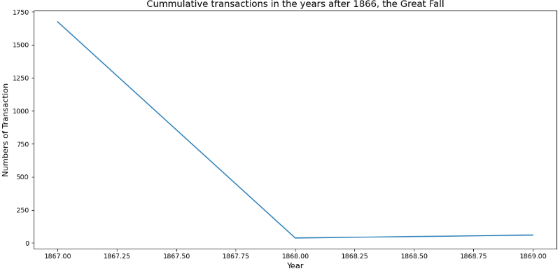
Exploratory Data Analysis
Cumulative Transaction Rate Time Line
OBSERVATIONS
1. Similar to the Tax rate through the year, the transaction rate drops correlatively too which shows a high correlation between Tax generated and transactions made.
2. No regular or pattern was observed during the years except for the general decline after the Great Decline which can be attributed to Data Gap.
RECOMENDATIONS
Transactions with all relevant countries A-list countries, should be monitored and encouraged.
Government policies that will aids or improve such transactions should be made.
In case of the Data Gap, Data Management system should be put in place in order to reduce to the minimal such data loss.

Slide 26
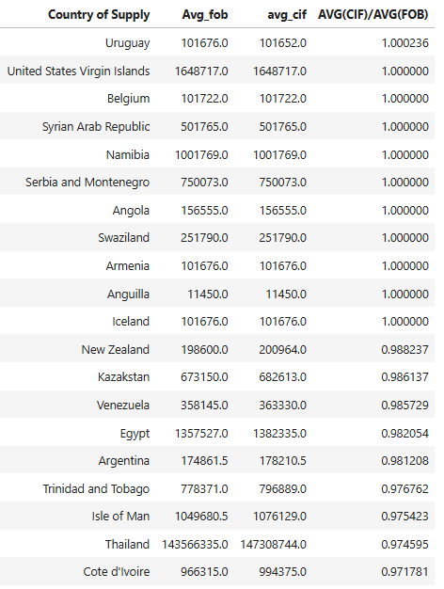
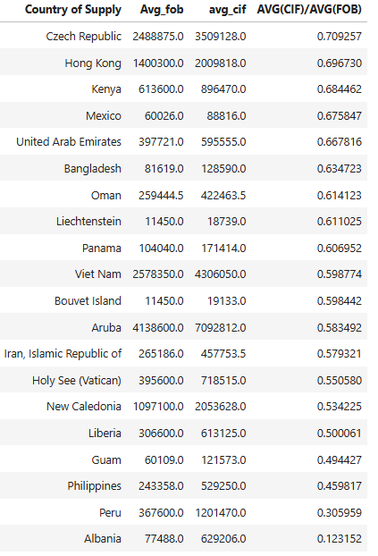
Exploratory Data Analysis
Logistics/Transport Cost
High Transport Cost Countries
Low Transport Cost Countries

Slide 27
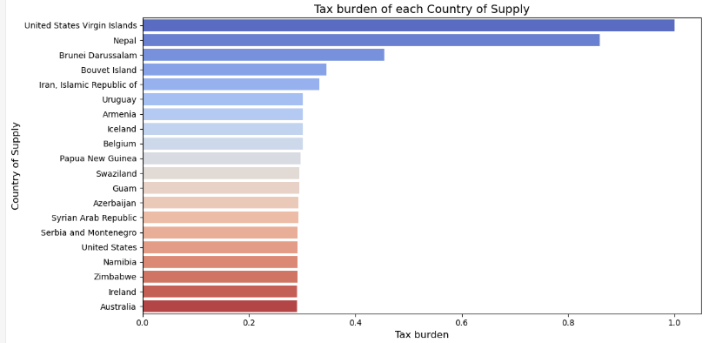
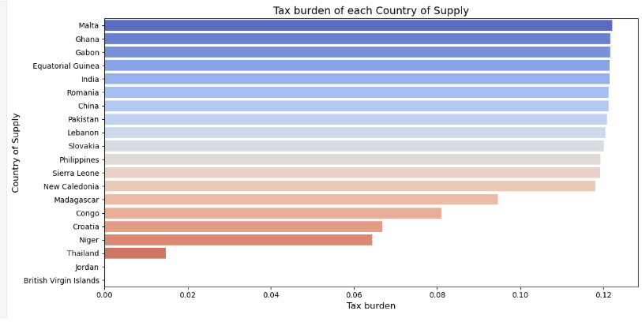
Exploratory Data Analysis
Tax Burden
High Tax Burden Countries
Low Tax Burden Countries
RECOMMENDATION
Because tax is affected by the FOB values, the following countries of supply are with lower tax burden and it is advisable if possible, importation should be made from there.
'Malta', 'Ghana', 'Gabon', 'Equatorial Guinea', 'India', 'Romania', 'China', 'Pakistan', 'Lebanon', 'Slovakia', 'Philippines', 'Sierra Leone', 'New Caledonia', 'Madagascar', 'Congo', 'Croatia', 'Niger', 'Thailand', 'Jordan', 'British Virgin Islands’
2. One of the factors that greatly affects importation is Foreign Exchange, Nigeria government should ensure stable economy between these nations in order to keep the FX at a lower side and encourage importers as well.

Slide 28
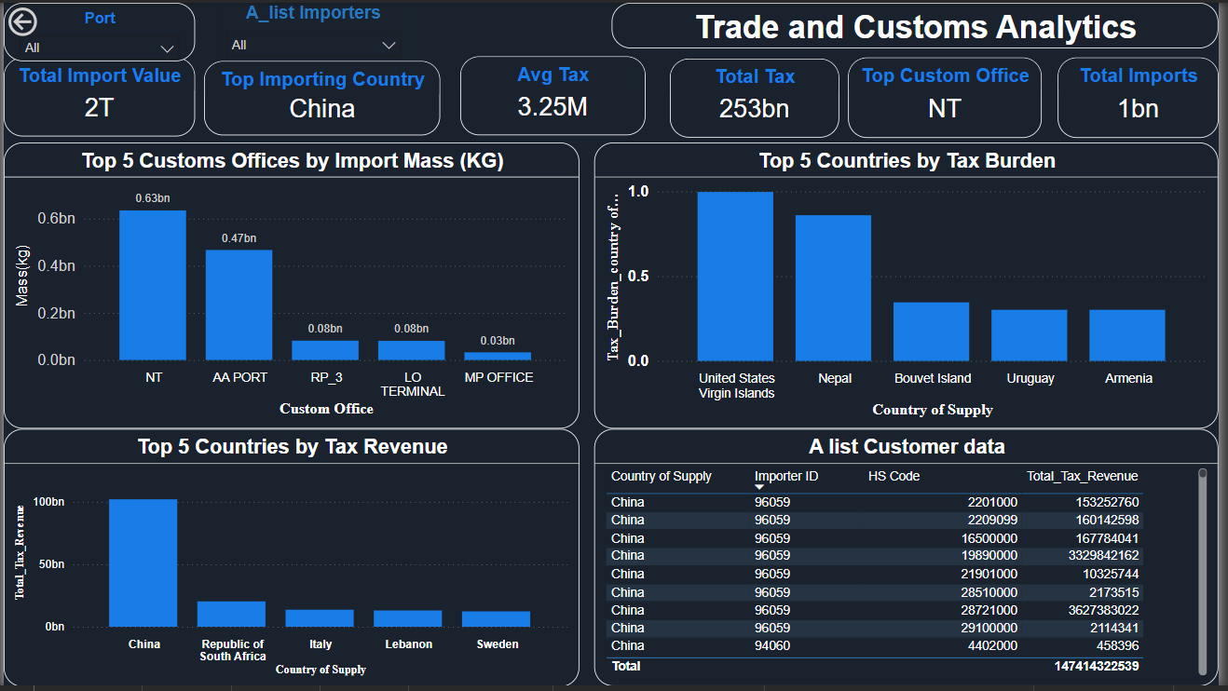
Data Insights
Dashboard
Insight:
This dashboard provides a comprehensive overview of our analysis, offering interactive drill-throughs and tooltips. These features allow users to explore data in greater detail, enabling a deeper understanding of key insights.

Slide 29
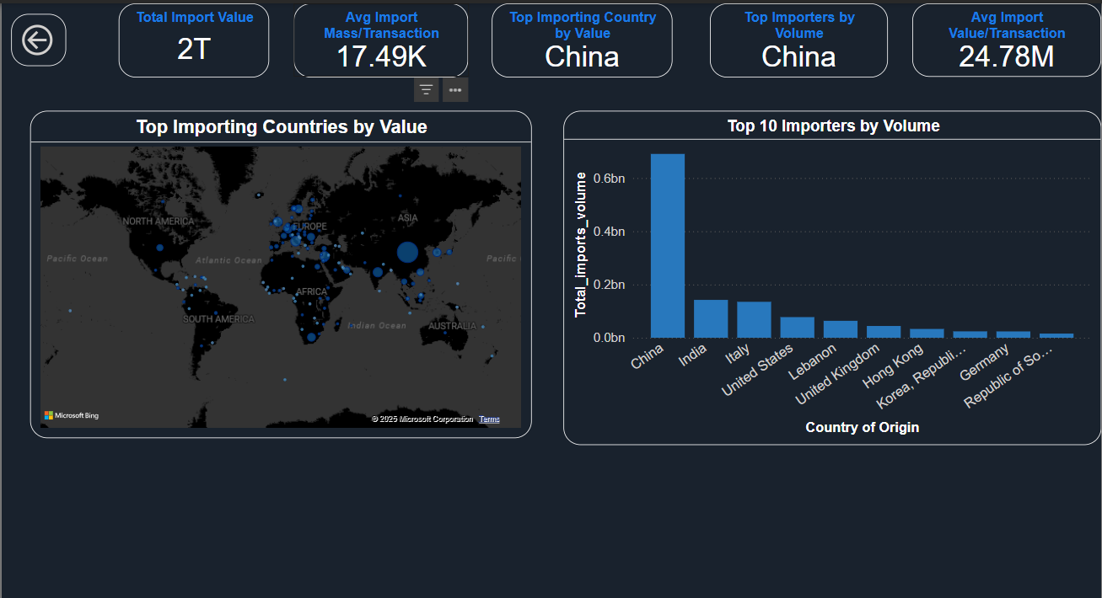
Import Volume and Value
Insight:
Our visualization highlights the top 10 importers by volume, with China leading the list, followed closely by India

Slide 30
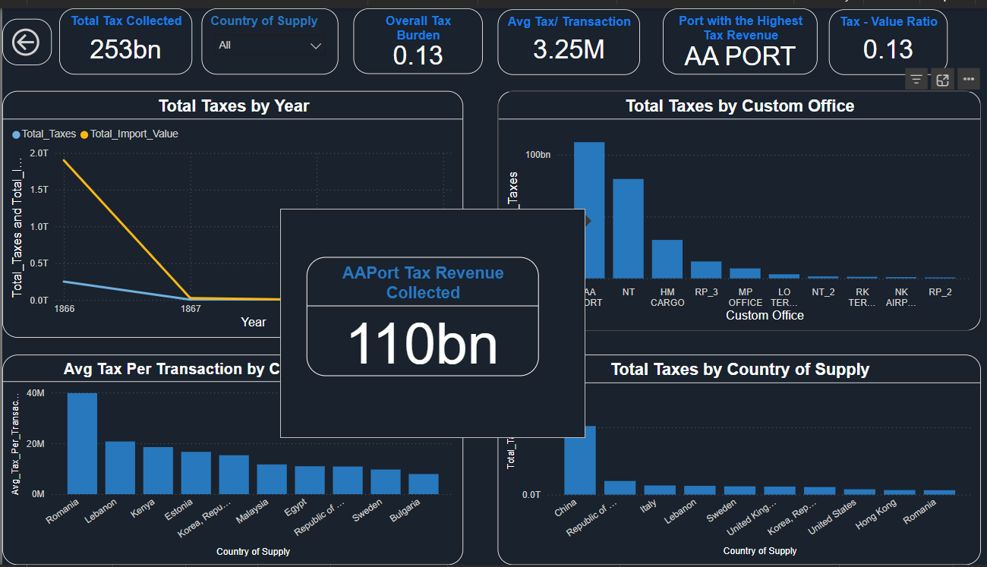
Taxation and Revenue
Insight:
Port AA leads in tax revenue generation, contributing 110 billion Naira. China emerges as the top country in overall tax generation, while Romania and Lebanon record high average tax per transaction

Slide 31
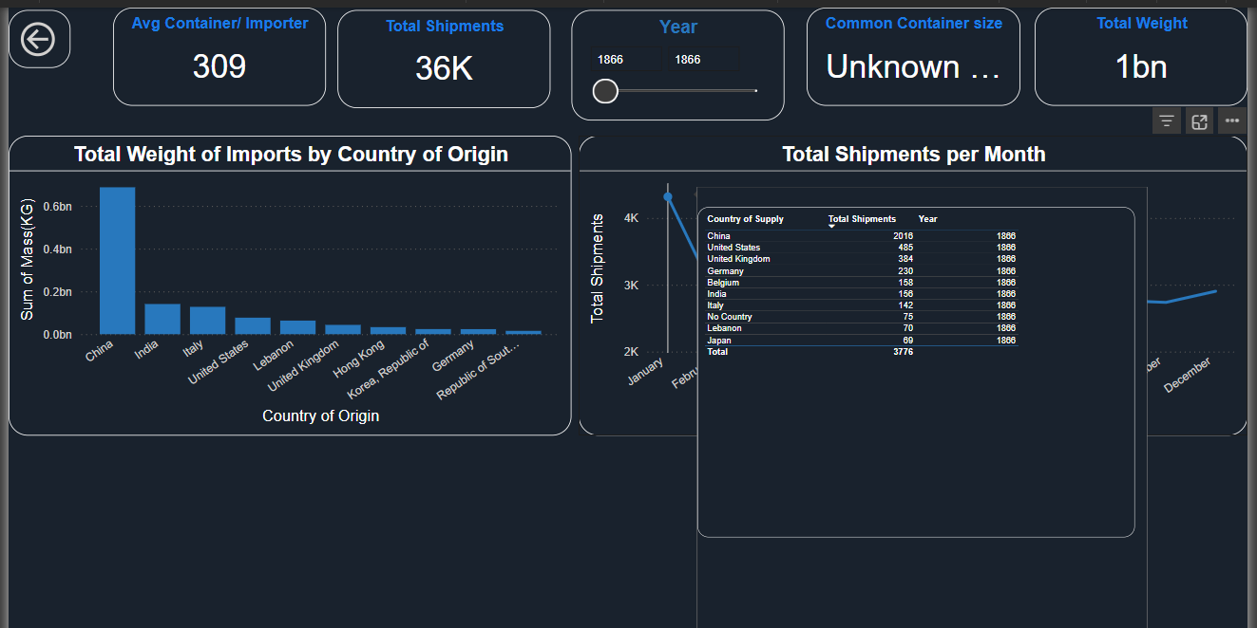
Logistics and Shipment
Insight:
This visual provides an overview of logistics and shipments, highlighting the total shipments made and the average number of containers per importer

Slide 32
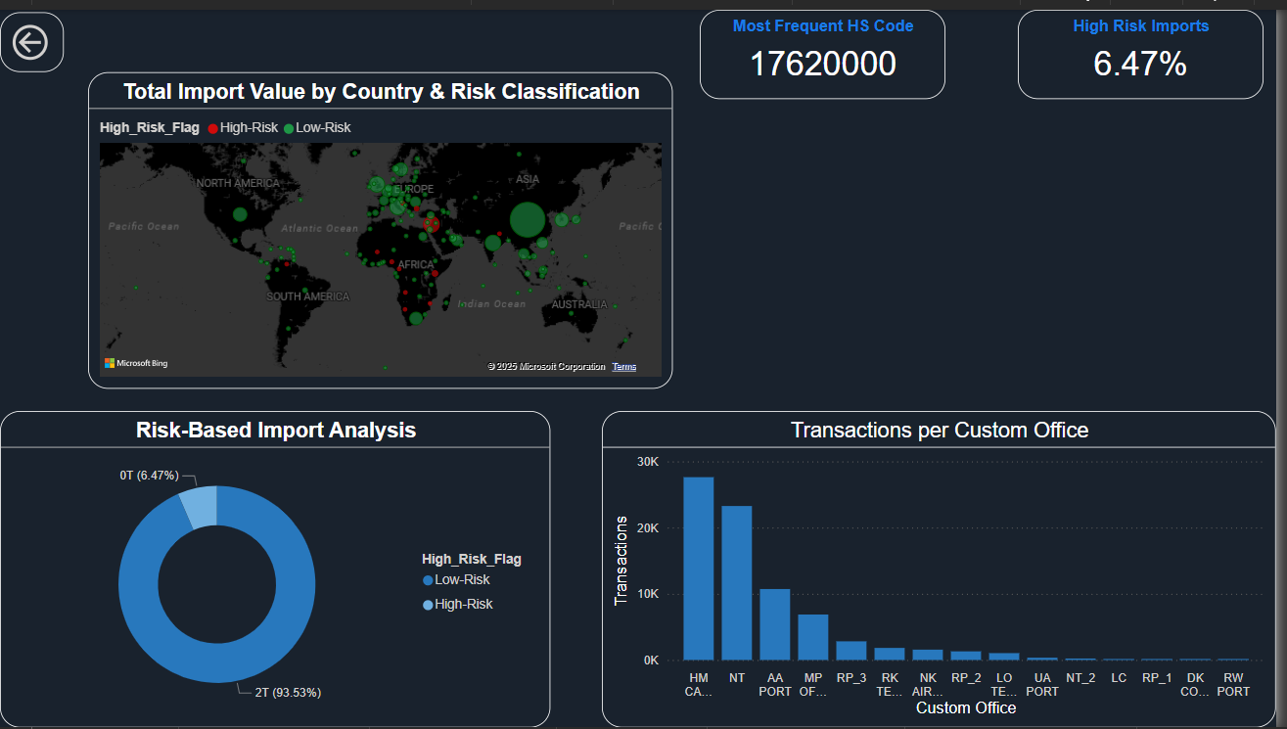
Compliance and Processing
Insight:
This visual highlights the most frequent HS code, the total percentage of high-risk imports, and the countries associated with high-risk shipments

Slide 33
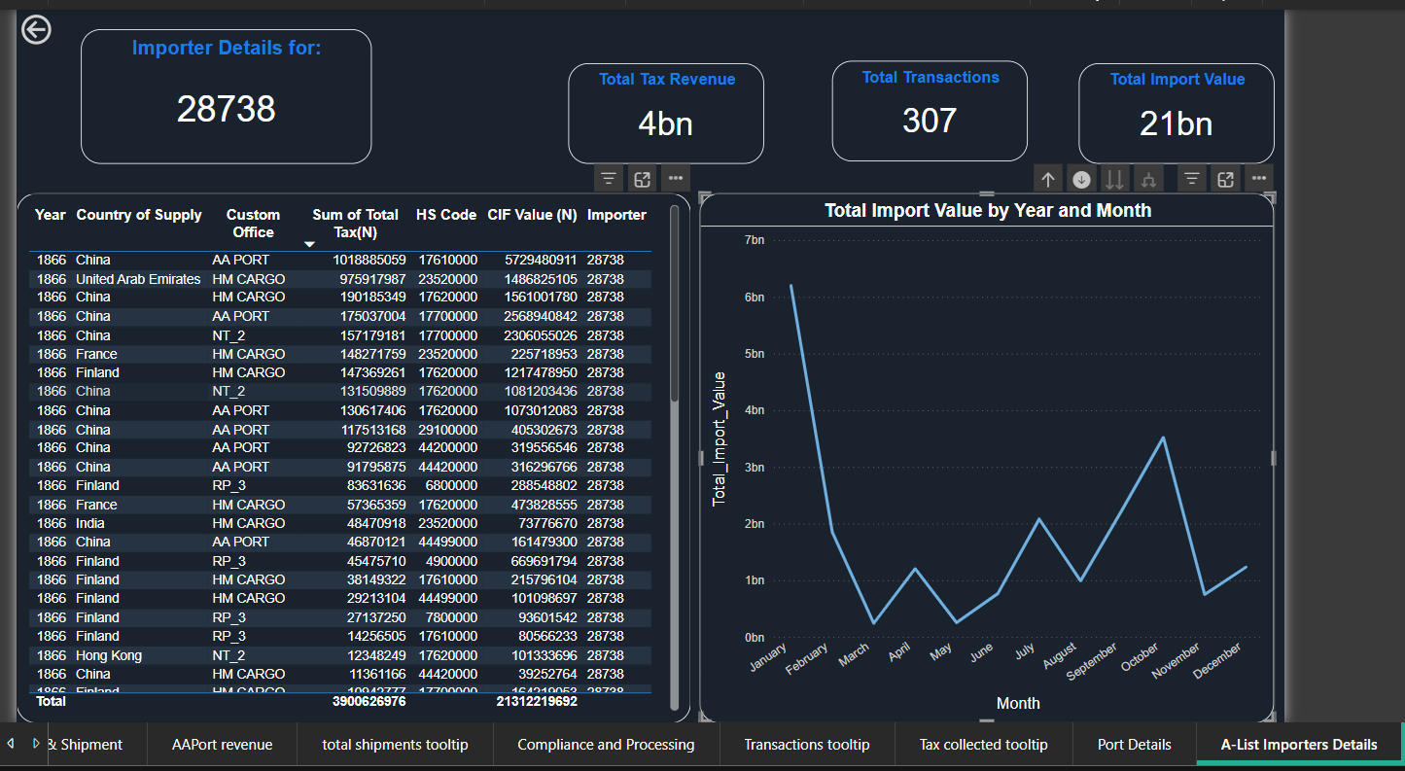
A-list Importers
Insight:
This visual shows our top Importers’ details, including the number of transactions, tax revenue, and other key metrics. It provides a deeper understanding of which importer contributes the most tax. Users can explore detailed insights for each importer using the drill-through function from the main dashboard, allowing for an in-depth analysis of their transactions and tax contributions

Slide 34
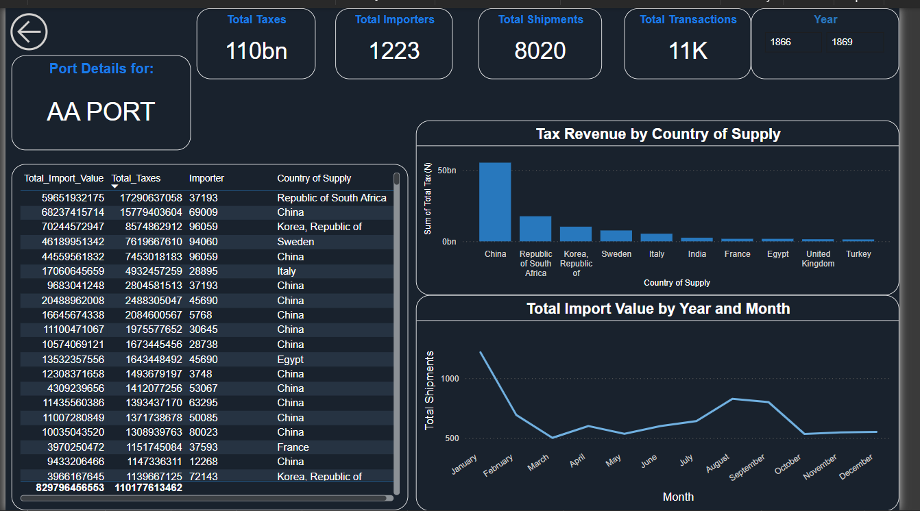
Port Details
Insight:
Port details allow us to dive deep and see insights such as total taxes generated, total shipments, and other key metrics for each port. The drill-through function from the main dashboard enables users to explore detailed insights for each port, facilitating an in-depth analysis of port-specific contributions and activities

Slide 35
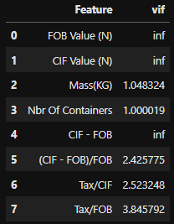
Predictive Analysis
Since the Tax generated is the main focus for the FGN, our target variable will be Tax awhile other features will be the independent variables.
As seen from the Correlation summary, most of the features have little correction with tax value, so we used RandomForestRegressor in order to be able to capture all the gaps and improve well on our features.
First VIF was performed in order to reduce multicollinearity and also decrease computation power by dropping the affected features.
The features with high VIF values (inf) was dropped and other features were used.
For categorical features, we will only pick the relevant ones based on the previous analysis done, subject-matter knowledge in order to avoid too high dimensionality in our model. The following will be dropped. Reg Number, Importer, Receipt Number, Country of Origin, Container Nbr,Container Size. Others will be treated with OneHotEncoder transformation.

Slide 36
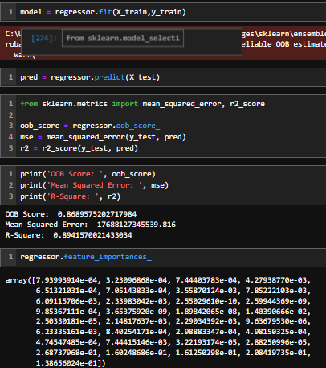
Predictive Analysis
We were able to train a regressor model with over 0.8 accuracy which makes it a reliable model.

Slide 37

Recommendations

Slide 38
Custom Office/Ports Ranking
Since NT port followed by AA plot have high weight imports, it is recommended that in order to have fast and safe moving of imports, investment of Heavy Lifting equipment should be concentrated at these ports.
NT port and AA ports have lots of container shipments than other ports, it is recommended that good road network and infrastructure should be ensured which makes sense giving their high weight imports. Also, more logistic staffs and Road Safety system and personnel should be deployed to the port.
HM Cargo has significant high transaction counts than other ports which shows that though they might not have heavy duty imports, they have low weights but high numbers of imports. It is therefore, recommended that rather than Lifting equipment, more staffs should be employed in order to handle the high traffic of transactions.
Private investors looking to invest in private logistics can look into NT port for container logistics businesses

Slide 39
Tax Generation
It is strongly advisable that Nigeria federal government should amplify and ensure their relationship with China is held steady as Tax generated is a large proportion of internal generated revenue and taxes from ports takes large portions.
Policy makers, Senate should make policies that fosters the relation with China.
A-List Products
The above products should be looked into and transactions involving them should be handled with more priority.
Government policy and assist could be done to ensure that the Demand for these products is sustained in the country.
A-List Customers
It is recommended that these 20 customers should be properly attended to in order to avoid churning because their import products forms 60% of the total taxes paid from China.
Time line of Tax Generation
1. The identified Data Gap should be looked into by management as well as government bodies in order to ensure adequate and effective record keeping methodology.
2. Data policy that enables access to data should be made in order to be able to analyze and make informed decision.

Slide 40
A-List Countries
1. The A-list countries are to be treated well by the Federal Government of Nigeria. Ensuring smooth relationship between Nigeria and the countries in order not to affect the imports from the countries. Foreign exchange and policies should be monitored.
Logistics
For Investors/Importers
Investors/importers are advised to import goods from the Low Transport Cost countries in cases where the goods needed can be gotten there too in order to avoid extra cost on transport.
Logistics companies should invest in the Low Transport Cost countries as Transaction rate will be more there.
For Governments
Government policies to encourage imports from the Low Transport Cost Countries.

Slide 41


Implementation Plan
Short-Term (0-6 months)
Investment in Heavy Lifting Equipment at NT & AA Ports - Conduct needs assessment, secure budget approvals, initiate procurement
Assess infrastructure needs, approve road expansion plans, hire additional logistic staff
Conduct staffing analysis, begin hiring process for HM Cargo
Conduct investor outreach, provide incentives
Initiate partnerships with logistics firms
Policy discussions with stakeholders to strengthen relations with China
Implement fast-tracking processes, review government assistance policies in handling A-list products and customers
Assess data collection issues, propose policy changes
Diplomatic engagements, review foreign exchange policies
Long term(2 years+)
Deployment and maintenance plan for heavy lifting equipment
Complete road projects, ongoing maintenance
Monitor investment impact and adjust policies
Maintain strategies based on trade flow
Hands-on workshops
Case Studies
Simulations

Slide 42
Implementation Plan
Resources Required
Financial Resources:
Budget allocation for infrastructure, equipment, and staffing.
Government incentives for private investors.
Human Resources:
Engineers and construction workers for road infrastructure.
Logistics personnel and port staff.
Policy analysts and government officials for trade relations.
Technical Resources:
Heavy lifting equipment procurement.
IT systems for data collection and monitoring.
Road safety and traffic control systems.
Legal & Regulatory Resources:
Trade policy adjustments.
Foreign exchange policy review.
Customs and tax regulatory frameworks.
Hands-on workshops
Case Studies
Simulations

Slide 43
Implementation Plan
Key Stakeholders
Government Bodies:
Nigeria Ports Authority (NPA)
Ministry of Transport
Ministry of Finance
Nigeria Customs Service
Senate & Policy Makers
International Partners:
China & Other A-List Countries
Foreign Direct Investors
General Public & Workforce:
Importers & Exporters
Local Communities
Road Safety & Security Personnel
Private Sector:
Logistics Companies
Port Operators
Heavy Equipment Suppliers
Private Investors
Hands-on workshops
Case Studies
Simulations

Slide 44


Conclusion
Key Takeaways:
Optimizing Tax Generation: The government should focus on high-performing ports and key importers to maximize revenue.
Strategic Investments: Heavy lifting equipment, road networks, and staffing improvements at major ports will enhance efficiency.
Policy Recommendations: Strengthening relationships with key trading partners, particularly China, is crucial for sustaining import-driven tax revenue.
Addressing Data Gaps: Improved record-keeping and data policies are essential for transparency and informed decision-making.
.

Slide 45
Conclusion
To sustain and enhance tax generation for the Federal Government of Nigeria (FGN), a strategic and data-driven approach must be adopted. The analysis highlights key trends in revenue generation, the role of major trading partners, and the importance of optimizing customs operations. Effective data-driven decision-making will empower stakeholders to drive meaningful improvements in Nigeria’s trade and customs processes.
By leveraging data-driven insights, strategic investments, and policy reforms, Nigeria can achieve a more efficient, transparent, and revenue-optimized customs system, ultimately contributing to national economic growth

Slide 46

References
Python, Excel and PowerBI tools were used.
Subject matter Knowledge was gotten from Nigeria Custom Service.
Stronger workplace culture and engagement
02
Increased productivity and efficiency
04
Enhanced Employee confidence

Slide 47
DataVerse
Africa
Thank You
Internship Presentation

